Slide 1
Preparation of Procurement Plan (PP)
A J Vedamurthy
Procurement Consultant
The World Bank New Delhi Country Office

Slide 2
Need for Procurement Plan
A Comprehensive procurement plan must be prepared :
To help the Borrower to effectively manage and monitor procurement activities;
To complete the envisaged project activities and thus minimize cost and time overruns;
Identify well ahead the critical paths or bottlenecks achieving the target set out in the plan and take corrective measures, if any
Notes:
Source: ADB/OECD

Slide 3
PROCUREMENT PLAN – As per Guidelines
Para 1.18 of the Bank’s Procurement Guidelines and Para 1.25 of the Consultant Guidelines provide as under:
The Borrower shall prepare
Preliminary Procurement Plan for the entire scope of the Project; and
Detailed and comprehensive procurement plan including all contracts for which procurement action/selection of consultants that will take place in the first 18 months.
An Agreement with the Bank shall be reached at the latest during loan negotiations.

Slide 4
PROCUREMENT PLAN - As per Guidelines
Further, Para 1.18 of the Bank’s PGL and Para 1.25 of CGL provide as under:
The Borrower shall update procurement plans throughout the duration of the project at least annually.
All procurement plans, their updates or modifications shall be subject to Bank’s prior review.
After loan negotiations, the Bank will publish on its external website the agreed initial procurement plan and all subsequent updates after a ‘no objection’ has been provided.

Slide 5
PROCUREMENT PLAN Templates
The Bank’s Website (URL: http://go.worldbank.org/9P6WS4P5E1) provides for the guidance of the Borrower the Template of the Procurement Plan.
A Sample Procurement Plan, based on the above referred template, has been presented in these slides for discussions.
Sample Procurement Plan
I. General
Bank’s approval Date of the Procurement Plan:
Original: …………
Revision 1: ……
B. Date of General Procurement Notice: …………(appeared in UNDB)
C. Period covered by this Procurement Plan: First 18 months of the Project

Slide 6
Formats of the Comprehensive PP
These formats incorporating the Procurement Schedule are shown in the following slides for:
Goods & Works
The format shown here may be used for ICB and NCB packages. However, a simplified format may be used for Shopping, and Direct Contracting packages, so as to indicate for each package: description of the goods/works, estimated cost, date of invitation of quotations, date of placement of contract and date of completion of contract.

Slide 7
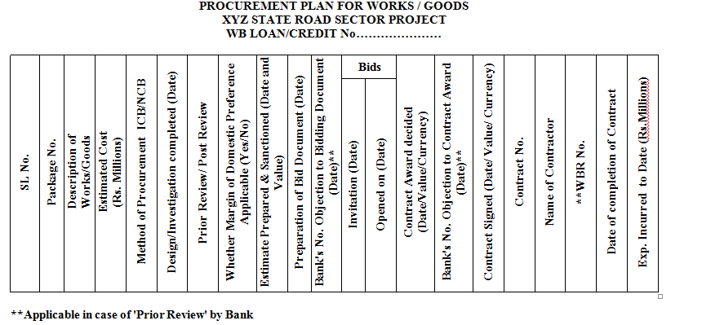
PP – Format for Goods and Works
Sample Format of the Comprehensive Procurement Plan for Goods & Works incorporating Procurement Schedule

Slide 8
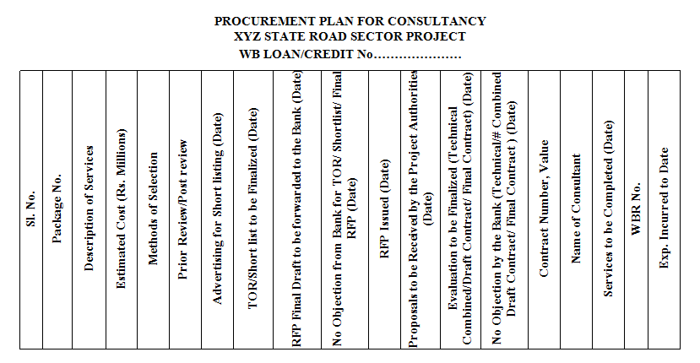
PP – Format for Consultancy
Sample Format of the Comprehensive Procurement Plan for Consulting Services incorporating Procurement Schedule

Slide 9
Exercise – 1: Preparation of Long List

Slide 10
PROCUREMENT Cycle
Completion
GPN
Contract Management
SPN
Contract Notification
Bidding
Evaluation
Opening
Discuss few aspects of ‘Procurement Plan’

Slide 11
Procurement Categories
Works
Goods
Service/Not Consultancy Services
The relative percentage of Works , Goods and Service/Non Consultancy Service may vary from project to project.
Notes:
Definition of Categories, Goods, Works and Services/Non Consultancy Services.

Slide 12
PROCUREMENT SCHEDULE - 1
The Borrower should incorporate the Schedule of procurement activities, listing out for each contract package/service, the time line for each procurement activity. As for example, specify:
In case of procurement of Goods, Works & non-consulting Services, timeline for invitation of bids, deadline for submission of bids, finalization of Bid Evaluation Report, Award of contract and Bank’s no objection for the prior review cases;

Slide 13
PROCUREMENT SCHEDULE - 2
The Borrower should incorporate the Schedule of procurement activities, listing out for each contract package/service, the time line for each procurement activity. As for example, specify:
In case of selection of consultants, timeline for issuing Request for Expression of Interest, Issue of RFP, submission of proposals, finalization of Technical Evaluation Report, opening of Financial Proposals, finalization of Combined Evaluation Report, Negotiations with highest ranked Consultant, draft negotiated contract & Final Contract, and Bank’s no objection for prior review cases.

Slide 14
Lead Time - Goods
Steps / Stage of the Procurement Cycle |  | Shopping | NCB (Prior) | NCB (Post) | ICB (Prior) | ICB (Post)
Preparation of Specifications, cost estimates, Sanction/approval and Bid documents |  | 2 Weeks | 2 Weeks | 2 Weeks | 2 Weeks | 2 Weeks
Prepare and Transmit Bid documents to World Bank |  | 2 Weeks | 2 Weeks | 2 Weeks | 3 Weeks | 2 Weeks
World Bank clearance of Bid documents |  | N/A | 2 Weeks | N/A | 2 Weeks | N/A
Issue invitation for Bid/RFQ |  | 1 Weeks | 1 Week | 1 Week | 2 Weeks | 1 Week
Bid Opening Date |  | 4 Weeks | 5 Weeks | 5 Weeks | 6 -12 Weeks | 6 - 12 Weeks
Transmit BER to World Bank for NOL |  | NA | 4 Weeks | 4 weeks | 4 Weeks | 4 weeks
World Bank clearance of BER |  | N/A | 2 Weeks | N/A | 2 Weeks | N/A
NoA (Notification of Award) |  | ASAP | 1 Weeks | 1 Weeks | 1 Weeks | 1 Weeks
Contract Signed Date |  | 1 Weeks | 4 Week | 4 Week | 4 Week | 4 Week
Expected date of delivery |  | Depend on the Type of Goods | Depend on the Type of Goods | Depend on the Type of Goods | Depend on the Type of Goods | Depend on the Type of Goods
Contract Completion Date |  | Start + Delivery Period | Start + Delivery Period | Start + Delivery Period | Start + Delivery Period | Start + Delivery Period

Slide 15
Lead Time -Works
S/No | Steps / Stage of the Procurement Cycle | Shopping | NCB (Prior) | NCB (Post) | ICB (Prior) | ICB (Post)
1 | Preparation of Specifications, cost estimates, Sanction/approval and Bid documents | 2 Weeks | 2 Weeks | 2 Weeks | 2 Weeks | 2 Weeks
2 | Prepare and Transmit Bid documents to World Bank | 2 Weeks | 2 Weeks | 2 Weeks | 3 Weeks | 2 Weeks
3 | World Bank clearance of Bid documents | N/A | 2 Weeks | N/A | 2 Weeks | N/A
4 | Issue invitation for Bid/RFQ | 1 Weeks | 1 Week | 1 Week | 2 Weeks | 1 Week
5 | Bid Opening Date | 4 Weeks | 5 Weeks | 5 Weeks | 6 -12 Weeks | 6 -12 Weeks
6 | Transmit BER to World Bank for NOL | NA | 4 Weeks | 4 weeks | 4 Weeks | 4 weeks
7 | World Bank clearance of BER | N/A | 2 Weeks | N/A | 2 Weeks | N/A
8 | NoA (Notification of Award) | ASAP | 1 Weeks | 1 Weeks | 1 Weeks | 1 Weeks
9 | Contract Signed Date | 1 Weeks | 4 Week | 4 Week | 4 Week | 4 Week
10 | Expected date of Completion | Depend on the Type of Works | Depend on the Type of Works | Depend on the Type of Works | Depend on the Type of Works | Depend on the Type of Works
11 | Contract Completion Date | Start+ Completion Period | Start+ Completion Period | Start+ Completion Period | Start+ Completion Period | Start+ Completion Period

Slide 16
Lead Time -Consultancy
S/No | Consultancy Steps | QBS(Quality Based Selection) | QCBS/FBS/LCS | CQ | IC (Individual Consultant) | Single Source
1 | Preparation of TOR, cost estimate, sanction etc., | 2 Weeks | 2 Weeks | 2 Weeks | 2 Weeks | 2 Weeks
2 | Transmit TOR and cost estimate to World Bank | 1 Week | 1 Week | 1 Week | 1 Week | 1 Week
3 | World Bank clearance of TOR and Cost estimate | 1 Week | 1 Week | 1 Week | 1 Weeks | 1 Week
4 | Trasmit EOI for publication to WB and Publication by the Project | 1 Week | 1 Week | 1 Week | 1 Week | N/R
5 | REOI (Closing Date) | 4 Weeks | 4 Weeks | 4 Weeks | 4 Weeks | N/R
6 | Trasmit Shortlist, Cost estimate and RFP | 4 Weeks | 4 Weeks | 4 Weeks | 4 Weeks | 1 week@
 | World Bank Clearance of short-list and RFP | 2 Weeks | 2 Weeks | 2 Weeks | 2 Weeks | 2 Weeks
7 | Issue of RFP | 1 Week | 1 Week | 1 Week | N/A | 1 Week
8 | Opening of RFP (Technical Proposal) | 6 Weeks | 6 Weeks | 6 Weeks | N/A | 6 Weeks
9 | Trasmit the TER (Technical Evaluation Report) to World Bank | 4 Weeks | 4 Weeks | 4 Weeks | N/A | 2 Weeks
10 | World Bank Clearance of TER | 2 Weeks | 2 Weeks | 2 Weeks | N/A | N/A
11 | Opening of Financial Proposal | 1 Week | 3 Weeks | 1 Week | N/A | 1 Week
12 | Trasmit CER (Combined Evaluation Report), Negotiation -Draft Contract to World Bank | 3 Weeks | 3 Weeks | 3 Weeks | N/A | 3 Weeks
13 | World Bank clearance of draft contract | 2 Weeks | 2 Weeks | 2 Weeks | N/A | 2 Weeks
14 | Signing of Contract | 2 Weeks | 2 Weeks | 2 Weeks | 2 Weeks | 2 Weeks
15 | Mobilization of Contract | 4 Weeks | 4 Weeks | 4 Weeks | 4 Weeks | 4 Weeks
16 | Contract Completion Date

Slide 17
Factors to be Considered…
The Procurement Plan should take into account the procurement strategy, and various factors like:
Size of the contracts taking into account availability of qualified suppliers/contractors and their capacity;
Packaging of contracts for similar goods and works;
Appropriate methods of procurement for goods & works (ICB, NCB, Shopping etc.) and consulting services (QCBS, CQS, LCS, Individual Consultants, etc.)

Slide 18
Lead Time and Procurement Cost
Shopping
NCB
ICB
High Lead time and Procurement cost

Slide 19
Methods of Procurement – Goods and Works
Procurement Methods:
Goods – ICB, NCB, Shopping, Frame work, Direct Contracting
Works - ICB, NCB, Shopping, Direct Contracting, Force Account

Slide 20
PROCUREMENT METHODs – Consultants
1. Methods of Selection:
The following methods of selection will be adopted depending up on size and complexity of assignment, as defined in the Consultancy Guidelines:
Quality and Cost based Selection (QCBS)
Quality Based selection (QBS)
Selection under Fixed Budget (FBS)
Least Cost selection (LCS)
Selection based on Consultants’ Qualification (CQS)
Single Source Selection (SSS)
Individual Consultants
Individual Consultants on SSS

Slide 21
Thresholds
II. Goods and Works and Non-Consulting Services
1 (a). Methods of Procurement:
* The threshold values as adopted by the Project are to be shown in this Table.
SN | Procurement method | Thresholds for procurement methods *
1. | ICB (Goods) | More than US$ 10,000,000 per contract
2. | NCB (Goods) | Up to US$ 10,000,000 per contract
3. | ICB (Works) | More than US$ 40,000,000 per contract
4. | NCB (Works) | Up to US$ 40,000,000 per contract
5. | Shopping for Works and Goods | Up to US$ 100,000 per contract
6. | Direct Contracting | Proprietary items, as detailed in the Procurement Plan
7. | Force Account for Works | As detailed in the Procurement Plan

Slide 22
Prior Review Thresholds
1 (b). Prior Review Threshold:
* The Threshold Values as adopted by a Project are shown in this Table.
SN | Procurement Method | Prior Review Threshold *
1 | ICB (Goods) | All contracts irrespective of value
2 | NCB (Goods) | More than US$ 1,000,000 equivalent per contract and First contract irrespective of value
3 | ICB (Works) | All contracts irrespective of value
4 | NCB (Works) | More than US$ 10,000,000 equivalent per contract.
5 | Direct Contracting | All contracts irrespective of value.
6 | Force Account | All contracts irrespective of value.

Slide 23
Prior Review Thresholds – Cont…
2. The method of selection to be adopted for each consultancy shall be mentioned in the Procurement Plan approved by the Bank.
Prior Review Thresholds
* The threshold values as adopted by the Project are to be shown in this Table.
SN | Selection Method | Prior Review Threshold *
1 | Competitive Methods (Firms) | More than US$ 200,000 equivalent per contract
2 | Single Source Selection (Firms and Individuals) | All contracts
3 | Individual Consultants (Competitive Methods) | More than US$ 50,000 equivalent per contract

Slide 24
PP Packaging
The factors to be considered for determining the size of packages will include:
- Timeliness
- Economies of Scale
- Geographical Location (dispersal of work)
- Institutional capacity of the Employer
- Capacity of likely qualified bidders
- Plant and equipment required

Slide 25
Decision Criteria for Contracting Strategy
High
Group items into Lots where the diversity of items is wide enough to justify separate Lots
Bid items individually where value is high. Otherwise group into Lots of similar nature
Total Value of Procurement Spend
Group Items into one Lot resulting in One Overall Contract
Group Items into Lots where estimated Lot Values are high to justify separate Lots
Low
High
Low
Diversity of Items to be Procured
Notes:
Deleted slide 46
Not clear

Slide 26
Packaging for Procurement
The Goods to be procured are generally identified during Project Identification stage or Appraisal stage – Unique Procurement Needs of Project.
Other Criteria which need to be considered for
contracting strategy are
technical complexity of items to be procured,
speed of delivery required,
after-sales servicing requirements,
competitiveness of supply market, and
critical milestones of the project (e.g. supplies for a hospital).

Slide 27
Packaging for Procurement
3. Lots shall be packaged/sized to attract maximum of competition-best value for money.
4. Disaggregation into small lots to avoid procurement process and review thresholds is strictly prohibited.
5. Similarly artificial consolidation of lots to avoid delegation to decentralized units is prohibited.

Slide 28
Packaging for Procurement
Procurement Package:- Either for a single item (description of Goods) or for a number of similar items with variable quantities and following the right method of procurement in awarding a firm contract to the lowest evaluated bidder. (Provided the selected firm has quoted for all the items)
Split Contracts:- many items procured under one Tender enquiry declared provision that price analysis would be done on the basis of lowest evaluated price of each item and either a contract placed on one firm or contracts awarded to more than one.

Slide 29
Q&A

